Slide 1
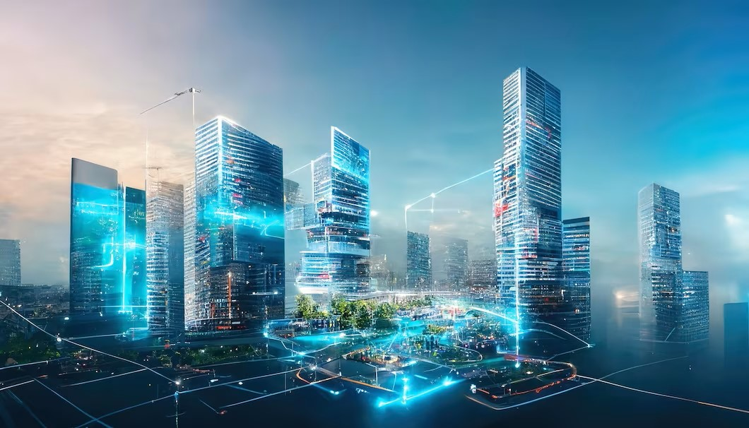
Digital Twin
EMPOWERING LIVES. BUILDING TOMORROW

Slide 2
Agenda
Digital Twin concept
Digital Twin layers
Digital Twin for buildings
Twin4build
Twin4build Architecture
Twin4build Component Architecture
Twin4build Capabilities
Architecture Reusability
Digital Twin case studies
Digital Twin for Bridge Displacement
Digital Twin for Flood Monitoring

Slide 3
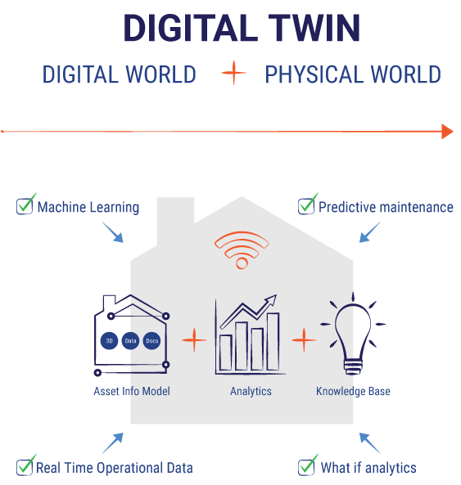
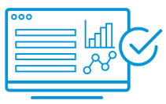

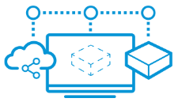

Digital Twin : Concept
What is Digital Twin?
Digital Replica of real-world system. Using data from multiple sources, a digital twin continuously learns and updates itself.
Decision-makers gain deep understanding, which they apply to improve and optimize the performance.
Why Digital Twin?
Growth trend of Digital Twin technology observed in Smart Cities & Manufacturing due to following benefits
Optimized performance
Actionable insights, simulations, and a connected view of all online and offline data enable quick and better decisions to optimize performance and efficiency.
Full view of all data
Eliminate data silos and unlock value across a project’s lifecycle with all historical data and real-time data in one place.
Faster results
Creating digital twins of complex assets, factories, and processes exponentially improve the value from operations, reduce development work, and increase time to market.
Smarter predictions
With real-time sensor data and predictive recommendations through machine learning and artificial intelligence, maintenance and operations are significantly improved.
Notes:
CO2 reduction, Energy optimization, circular economy

Slide 4
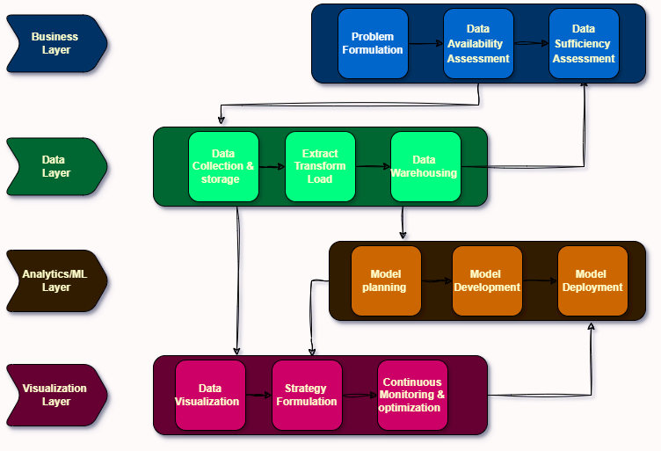
Digital Twin Layers
Role of each layer
Business Layer: Understand the problem, check if we have the needed data, and assess if the data is enough.
Data Layer: Gather, organize, and store data properly for analysis.
Analytics Layer: Plan, create, and put into action the models that will analyse the data.
Visualization Layer: Display the results clearly, make plans based on them, and keep improving the system.
Notes:
CO2 reduction, Energy optimization, circular economy

Slide 5
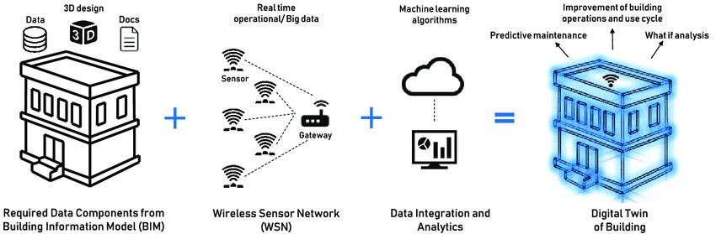
Digital Twin for Buildings
A digital twin for buildings is a virtual replica of a physical building, containing detailed information about its structure, systems, and operations. It helps building owners and managers monitor performance, optimize energy usage, and identify potential issues to improve efficiency and maintenance.
Notes:
CO2 reduction, Energy optimization, circular economy

Slide 6
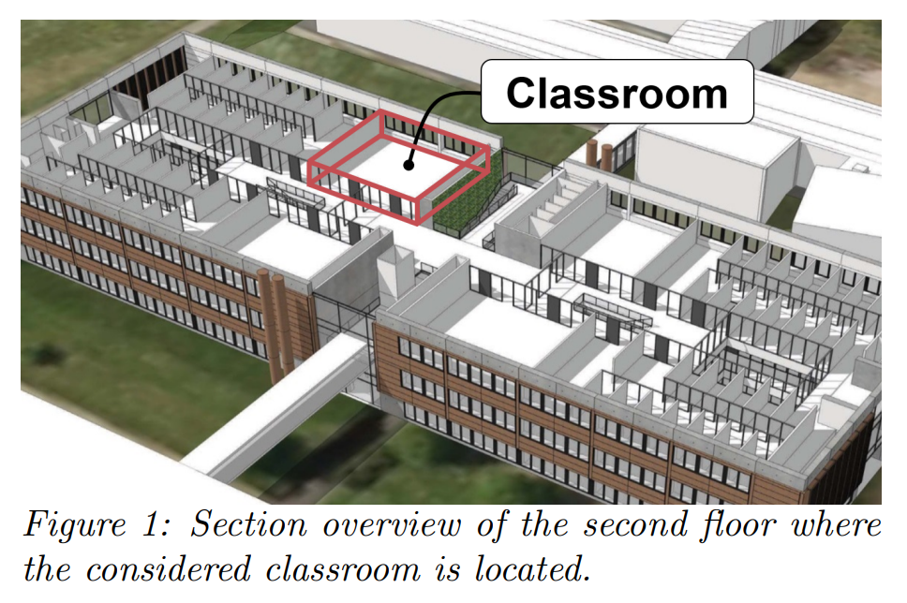
Twin4build
A digital building twin is a virtual replica of a physical building and all associated technologies, systems, equipment, sensors, and actors.
Business Problem
To create a Digital Twin platform for Smart Buildings by leveraging the advantages of FIWARE, BIM, AI/ML and SAREF Ontology.
Enable prediction, alerts for temperature and CO2 using AI/ML
Business Target
Develop FIWARE Platform for Smart Buildings ( FIWARE as a Service)
15% reduction in energy demand during the operational phase.
25% reduction in C02 other greenhouse gas emissions
Solution
Designed scalable & reliable application architecture on Azure
Developed HVAC based system to predictive maintenance and what-if analysis for building.
Develop analytics models for energy prediction and CO2 emission
Interactive dashboard creation for energy monitoring and prediction
Automate deployment of solution using terraform pipeline
Notes:
CO2 reduction, Energy optimization, circular economy

Slide 7
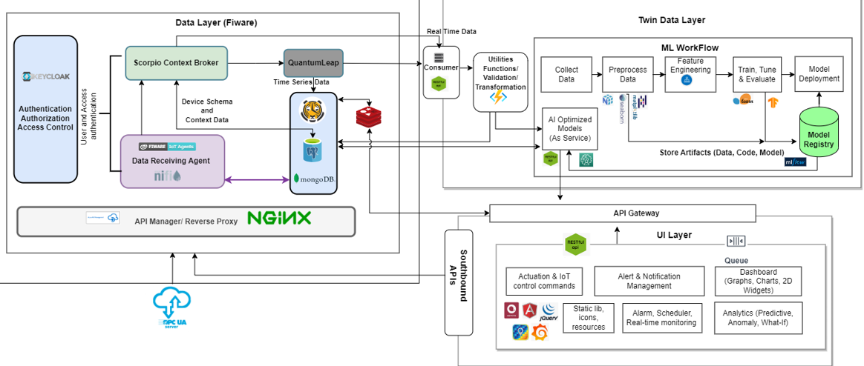
Twin4build purposed Architecture
Notes:
CO2 reduction, Energy optimization, circular economy

Slide 8
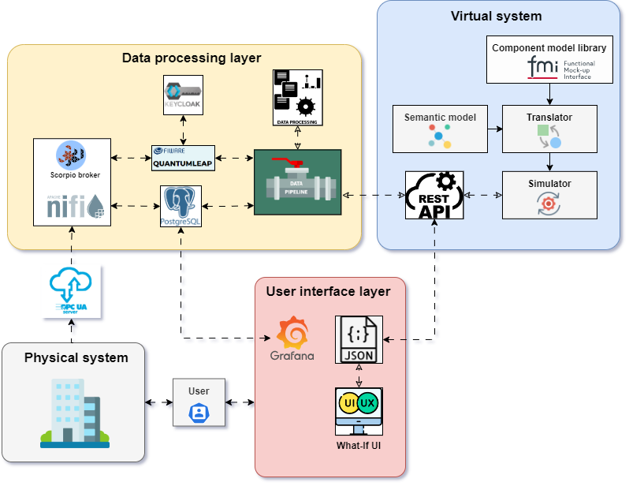
Twin4build Component Architecture
Notes:
CO2 reduction, Energy optimization, circular economy

Slide 9
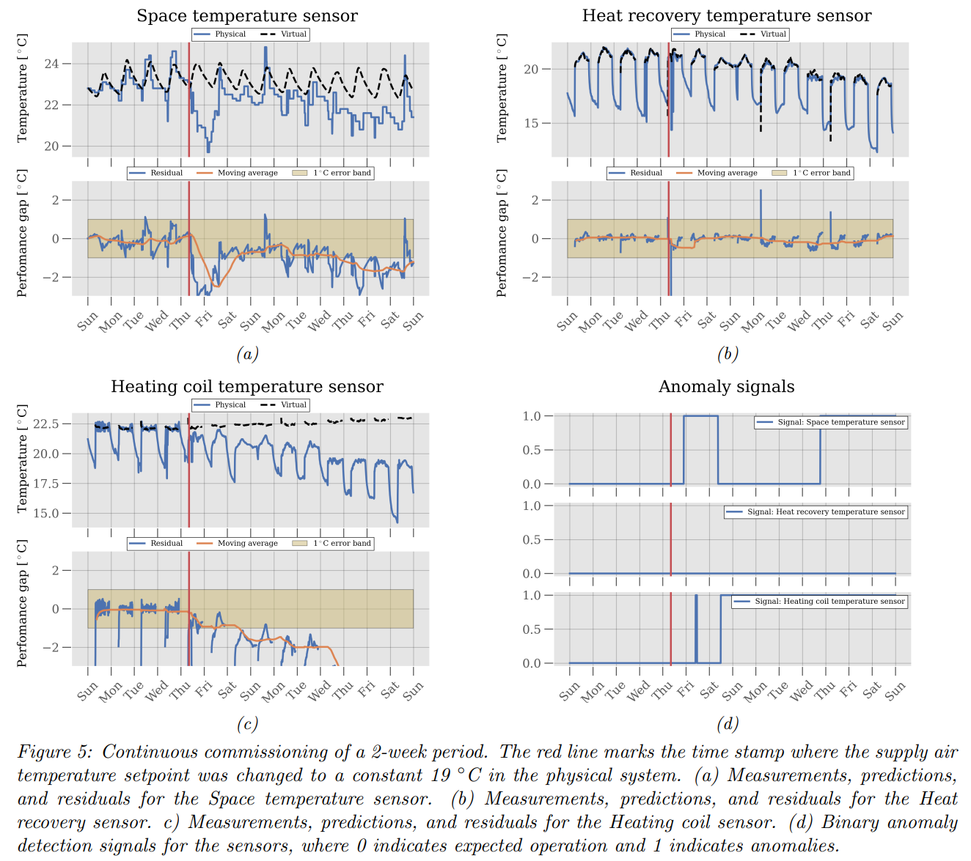
Twin4build Capabilities
Predictive Maintenance
Predictive maintenance uses data analysis to identify operational anomalies and potential equipment defects, enabling timely repairs before failures occur.
Link: Grafana dashboard link
Performance Monitoring
Performance monitoring in buildings with a digital twin means keeping a close eye on how the building is doing in real-time.
Link: Grafana dashboard Link
Notes:
CO2 reduction, Energy optimization, circular economy

Slide 10
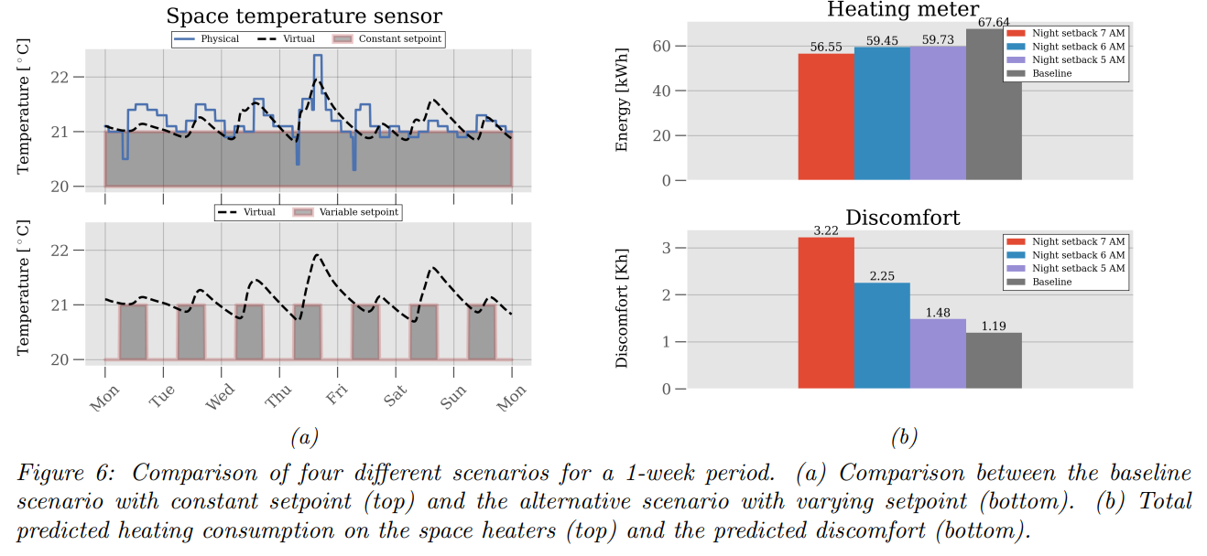
Twin4build Capabilities
Operational Planning
Operational planning means figuring out how to run the building effectively. By using the digital twin, we can plan ahead and keep the building running efficiently, saving time and money while ensuring comfort for everyone inside.
What-If Scenarios
What-if scenarios with a digital twin for buildings mean asking questions like "What if?" and seeing how changes might affect the building. It's like a virtual playground where we can try out different ideas. For example, we can see what happens if we adjust the temperature or change the occupancy of room. By doing this, we can make smarter decisions about how to improve the building and make it better for everyone.
Notes:
CO2 reduction, Energy optimization, circular economy

Slide 11
Architecture Reusability
Components To Be Updated
As Is
New Components
Use Case
Security
Visualization
Charts
Time Series
Monitoring
GIS
Data Encryption
Simulation
3DModelling
Dashboards
Heatmaps
Digital Twin Monitoring
Modelling
Action
Response
Model Simulation
Actuation Interface
Access Control
SOPs/Rules Engine
Model Maintenance
Recommendation Engine
Decision Engine
Model Development
Data Insights
Data Analytics
Knowledge Graph
Reporting
Device Monitoring
Authn & AUTH
Data Processing
Data Storage
Reasoning Engine
Data info
Network Monitoring
Data Auditing
Data Collection
Data Storage
Data Management

Slide 12
Digital Twin Case Studies

Slide 13
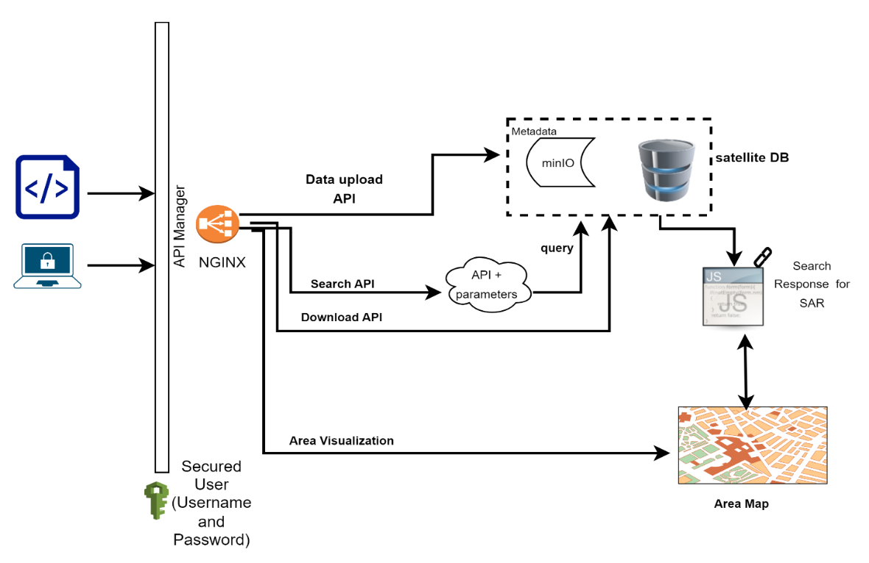
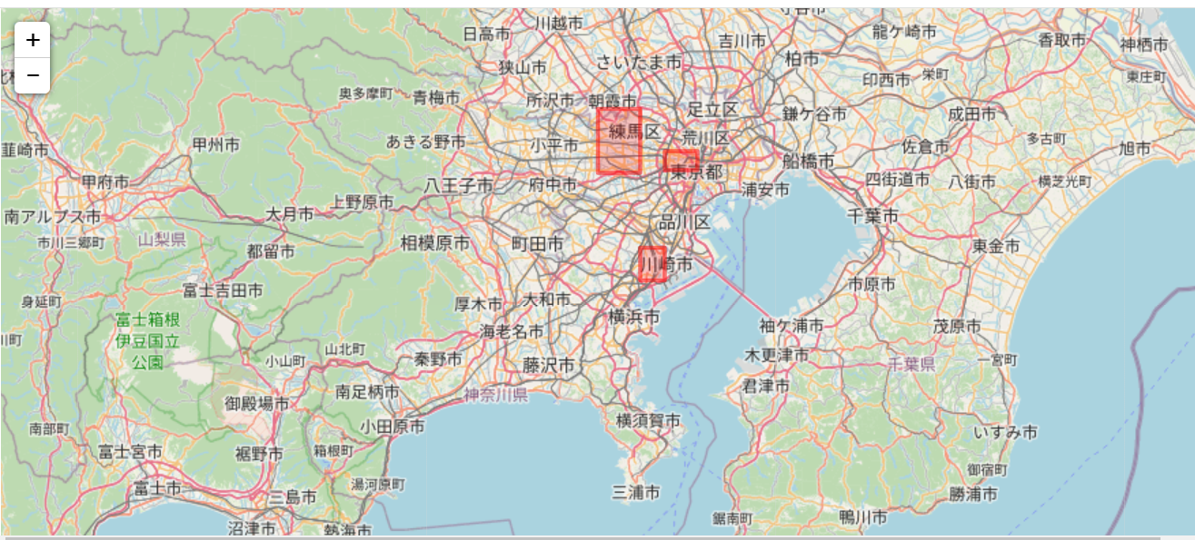
Satellite Displacement Analysis
Anomaly Detection and Prediction
Challenges
Solution Proposed
Expected Results
Expected Benefits
Traditional methods for disaster prediction might rely on ground sensors or weather forecasts, which can have limited reach or accuracy.
Some disaster-prone regions are geographically challenging to access, making ground-based monitoring difficult or dangerous.
Regular download of Sentinel-1 SAR, Orbit and DEM data.
Use of minio high-performing distributed object storage solution to enable analysis of heavy object ( 3 GB – 9 GB)
Highly optimized DB designing to support quick response time of Search Queries
Early warning systems e.g. impending landslide, volcanic activity, or even the initial stages of a flood
Allows authorities to do near to real monitoring
High Resolution Monitoring of Remote and Inaccessible Areas
Improved Accuracy by analyzing historical satellite data alongside real-time information
Early detections will provide valuable time for issuing early warnings and evacuations
Guiding rescue and response efforts towards the most critically affected areas.
Providing vital data from remote inaccessible areas for informed disaster response strategies.
Region based solution provides total control & swift accessibility as per local authority preferences
Key Features
High Resolution Data for focused Area Of Interest
Offline Data Repository & Analytics capabilites
Customized repository for DEM & Orbital SAR data
Script and API for easy access
Roadmap
Leveraging real-time satellite data (SAR & DEM) and advanced modeling, we can predict landslides, identify bridges needing maintenance, and proactively prevent disasters
Streamlined workflow
Granular download option
Notes:
CO2 reduction, Energy optimization, circular economy

Slide 14

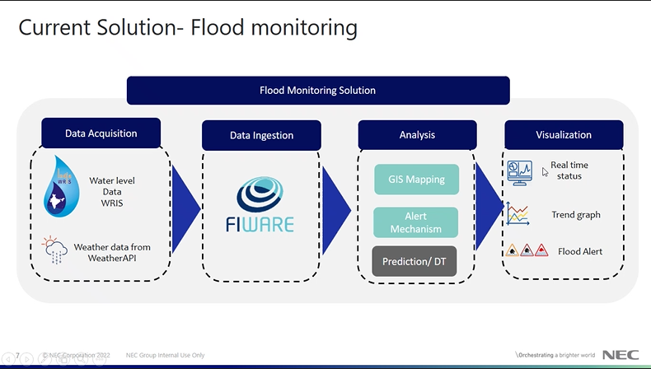
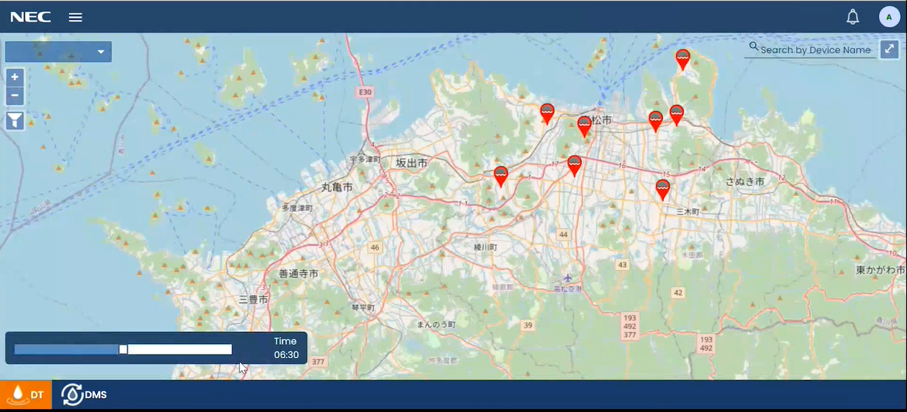
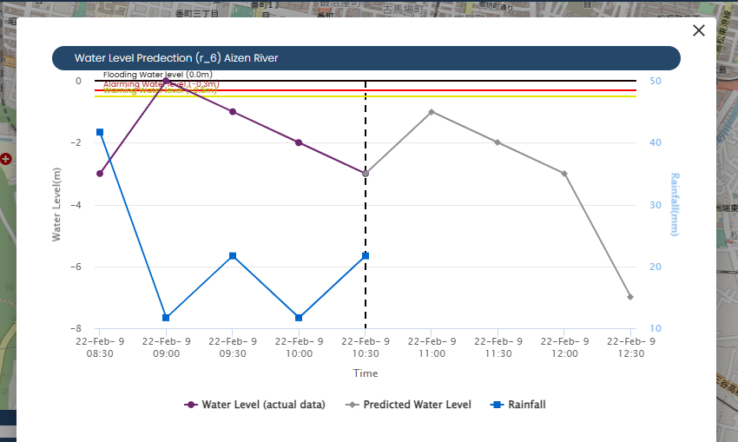

Digital Twin for Flood Monitoring
Digital Twin
Digital Twin
FIWARE
Disaster Prevention
Provide solution to facilitate the end users :
Several different parameters of weather, tide, river can be seen in the trend graphs
Water level Prediction showing 2 hrs. ahead in time at a frequency of 30 minutes
Visualization Dashboard & Water level transition in trend graph
Visualization
Dashboard
Overall System Flow
Visualization
Dashboard
Water level Prediction showing 2 hrs. ahead in time
Project Duration: 4.5 months
Project Size: 51 MM
Customer: CIU, NEC HQ, Japan
Tool /Technologies Used: Java 8, Micro-services , FIWARE Orion, Draco CrateDB, Apache NiFI, Kafka, Jupyter, Scikit-Learn, Hydrosphere (ML), Echart
NECI Responsibilities: Full SDLC cycle for development, System Design & Integration for FIWARE. AIML modeling
Solution
Business Problem
NEC Solution
Business Benefit
Business Problem
Data Modeling and training from different data set taken from g Weather and WRIS Open data
Apply Analytics and predict the flood condition by Digital Twin AI/ML Modeling
Data ingested using FIWARE Data Platform
Analytics are performed based on 7 day past data set and weather data and model is trained in DT stack
Visualization using ICCC
Prediction of river level 2 hrs. ahead of current time
Detail visualization of current data and monitoring using visualization chart & graphs
Different weather parameter historical data trend

Slide 15
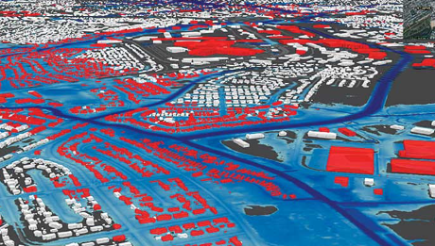
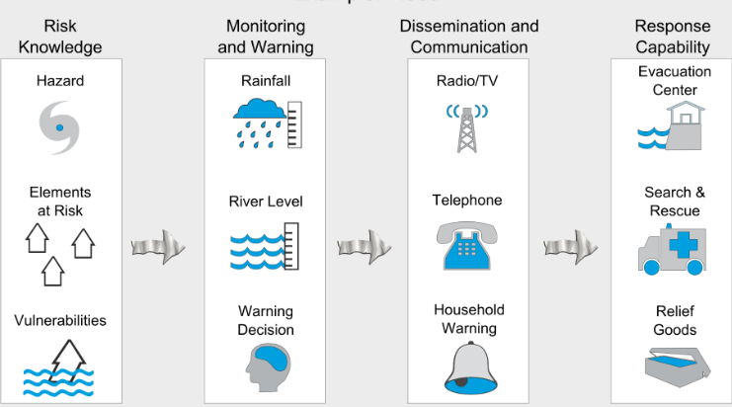
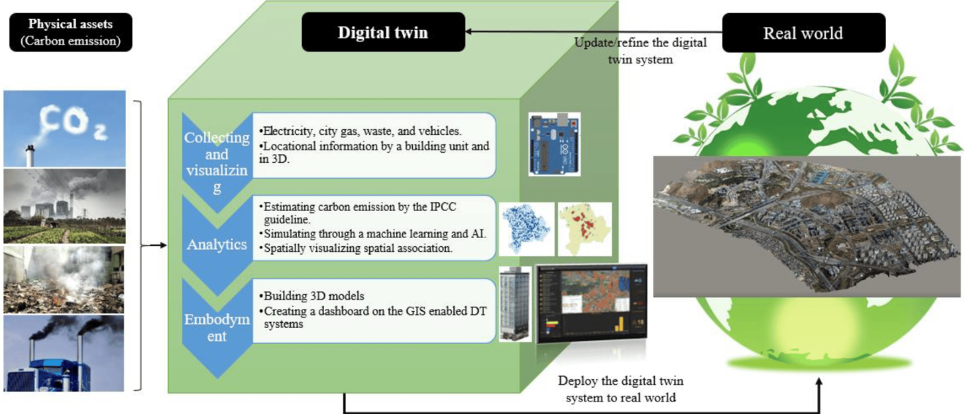
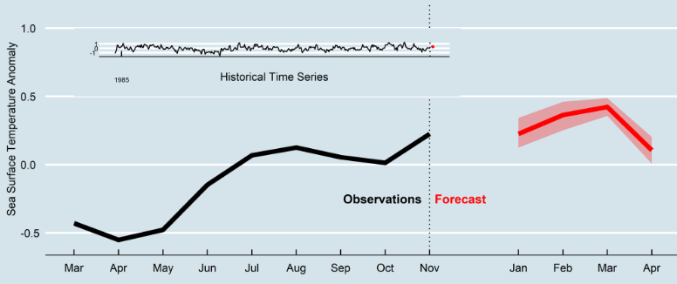
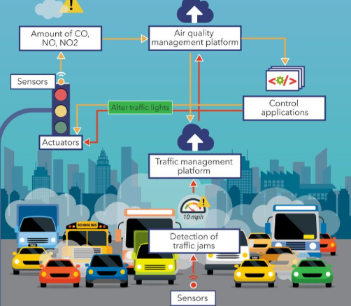
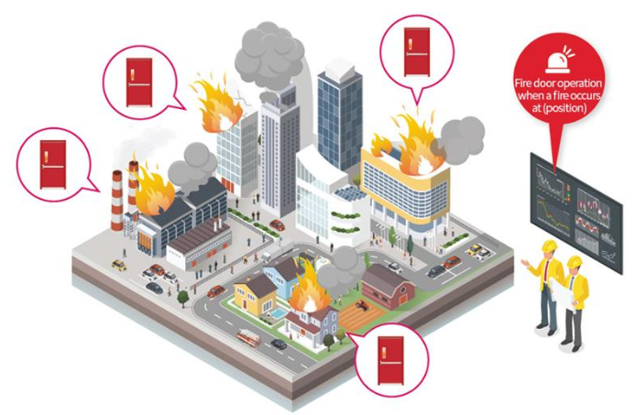
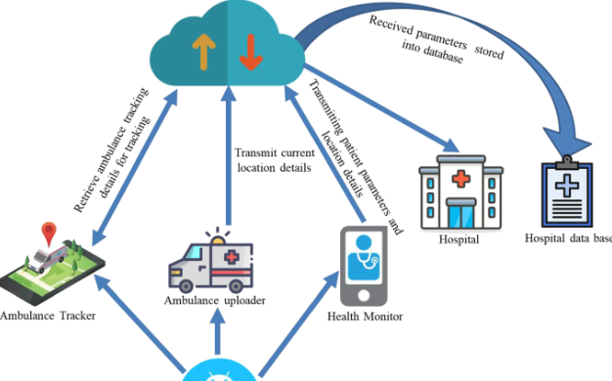
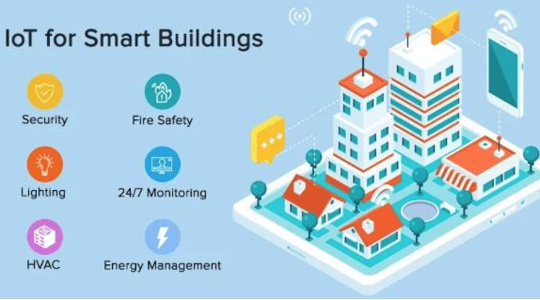
Digital Twin Potential Use Cases
Flood Inundation Depth Simulation (Disaster Management)
Early Warning Systems
CO2 reduction Twin, Carbon Credits
Heatwave Prediction system
Smart Traffic Management
Smart city Fire management
Smart healthcare management
Smart Building Management
Indicative use cases - not limited to these
Notes:
CO2 reduction, Energy optimization, circular economy

